Slide 1

XIAMEN PICVALUE CORP.
Since 2005
Add:Unit 1106, No. 3 Bldg, Yuanbo Business Centre,
516 Xinglinwan Avenue, Jimei District Xiamen 361022, Fujian, China

Slide 2
Profile
Years In Business: 16
2021 Sales Amount: USD12,000,000,000
Main Markets (%): Europe 40%, USA 40%, SOUTH AMERICA 15%, Europe 5%, OTHERS
Office have over 16 employees: 10 sales, 2 quality inspector, 1 administrator, 1accountant and 1designer

Slide 3
Profile
Key Customers (Country):
TJ MAXX (USA), The Royal Standard (USA)
Kroger(USA), MOAM Group(USA)
Wal-Mart (USA, Canada, Brazil, Mexico), Enchanté Accessories lnc(USA)
Bed, Bath & Beyond (USA, New Zealand), Belk (USA)
Ross Procurement Inc. (USA),
BJ’s Wholesale Club (USA),
Sam’s Club (USA)
JC Penney (USA),

Slide 4
Profile
Key Customers (Country):
VOG (Austria, Czech, Poland, Hungary)
Joinco Importação e Exportação, Lda (Portugal),
TAMMER-TUKKU (Finland)
Stokomani Siege (France)
Coles(Australia)
TK MAXX(Australia)
Wolt(Finland, food delivery bag)

Slide 5
Strengths
Product Range:
Cooler Bags
Tote Bags
Picnic Bags, Picnic Backpacks
Beach Bags, Shopping Bags
Picnic Blankets, Beach Mat
Food Delivery Bags
Material: polyester, rpet, non-woven, canvas,PVC

Slide 6
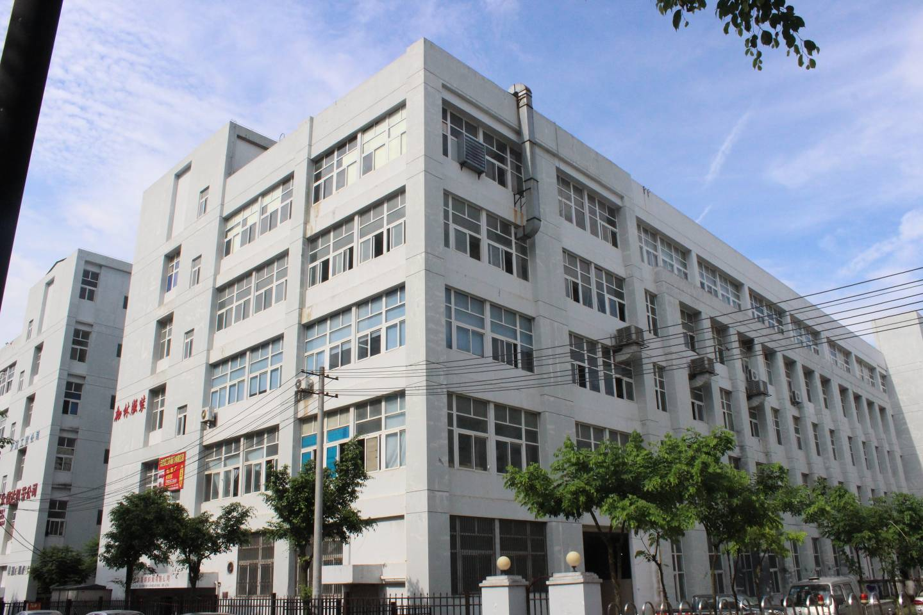
Factory
2016-7-27

Slide 7
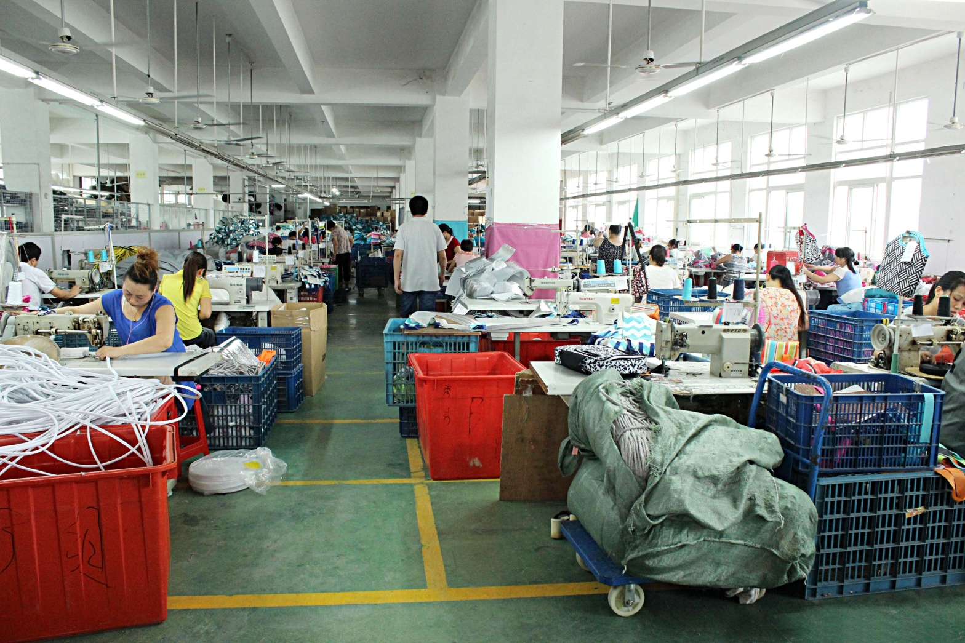
Factory
2016-7-27

Slide 8
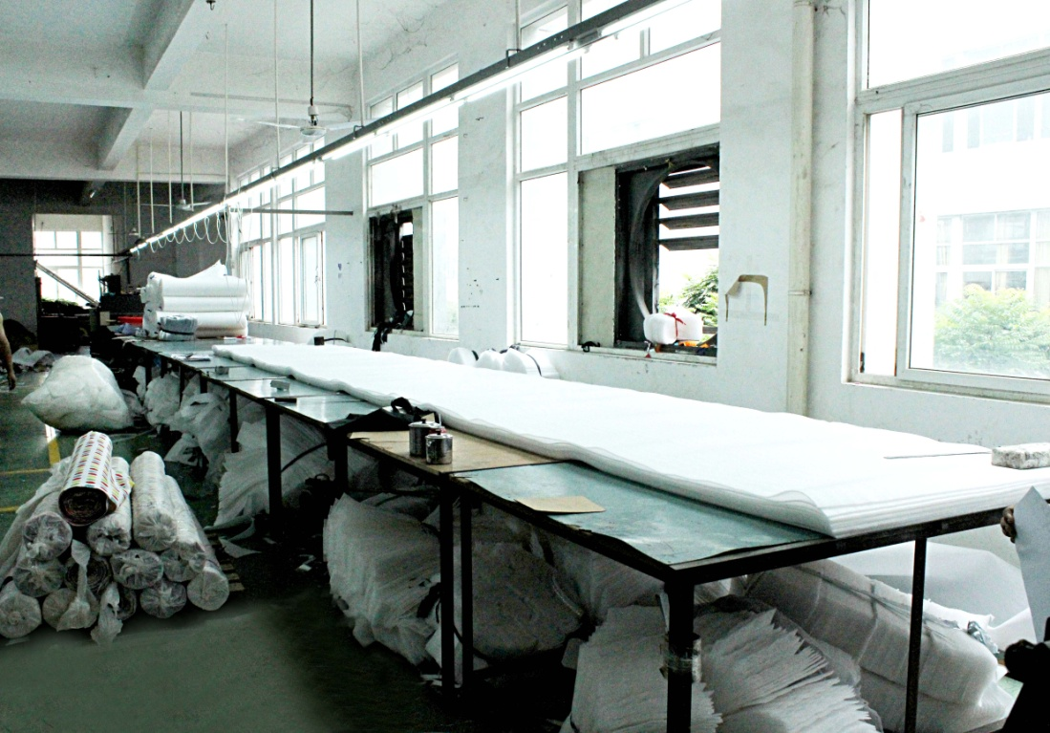
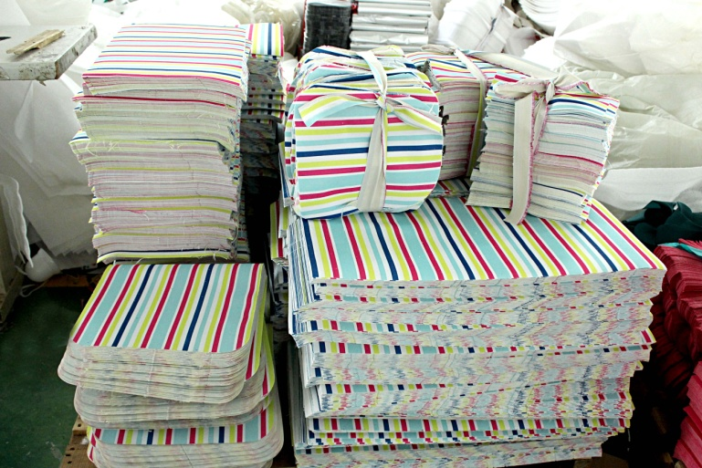
Factory

Slide 9
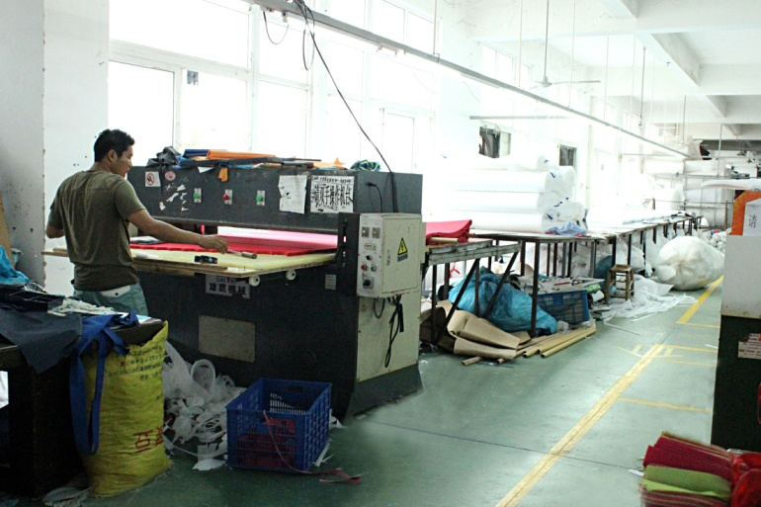
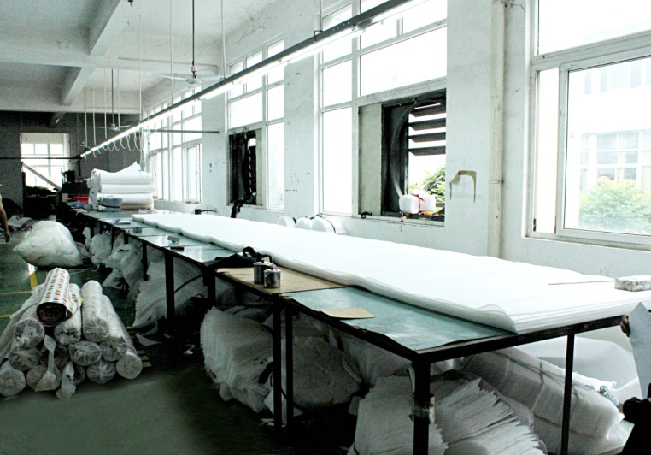
Factory
Worker: 80
Design Dept.: 4
QC Dept. 6
Production Dept. 5

Slide 10
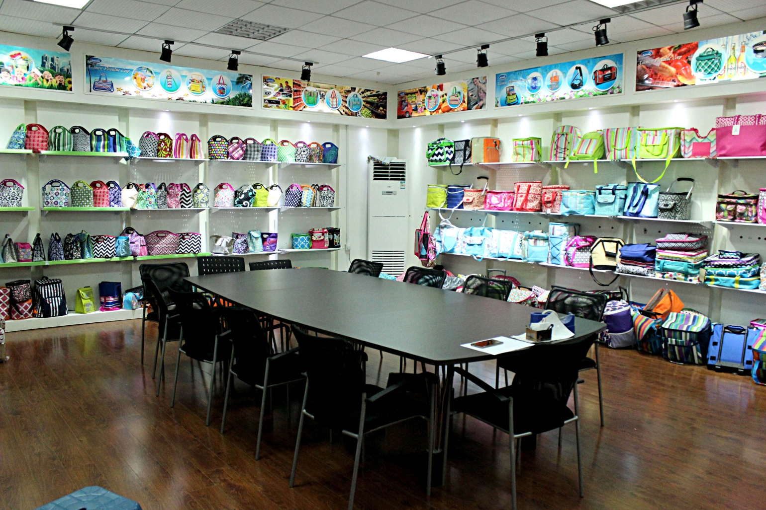
Showroom

